Slide 1

Julia for High Performance Computing
Carsten Bauer
20-23 September 2022

Slide 2
Schedule

Slide 3
Course Material
github.com/carstenbauer/JuliaHLRS22

Slide 4
Live Survey

Slide 5
Why Julia for HPC?

Slide 6
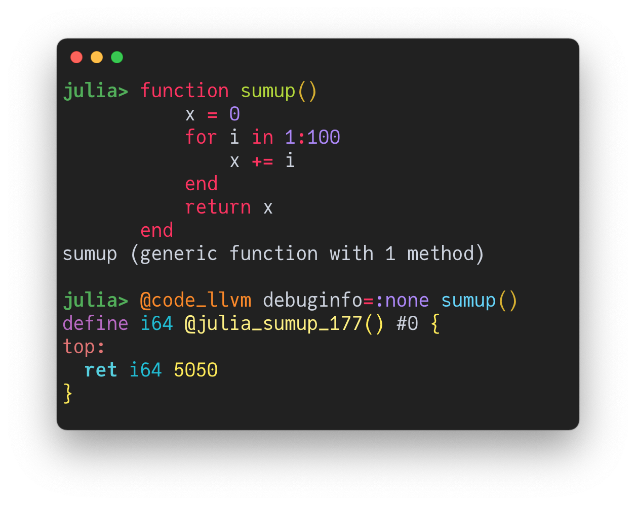


The Julia Programming Language
Great for domain science
“Python-like” syntax
Dynamic & interactive
powerful REPL
Jupyter notebooks (Julia + Python + R)
Powerful linear algebra + ecosystem
Package manager, environments
Great for HPC
Compiled via LLVM (just ahead of time)
Parallel computing
Hardware accelerator programming
High-level abstractions + low-level kernels
Interactive HPC

Slide 7



Bridging the Gap
Domain Science
HPC
”Julia: come for the syntax, stay for the speed”
DOI: 10.1038/d41586-019-02310-3

Slide 8


Bridging the Gap
prototyping / slow
production / fast
Julia covers the spectrum between those two “limits”
and can often provide the best of both worlds!

Slide 9
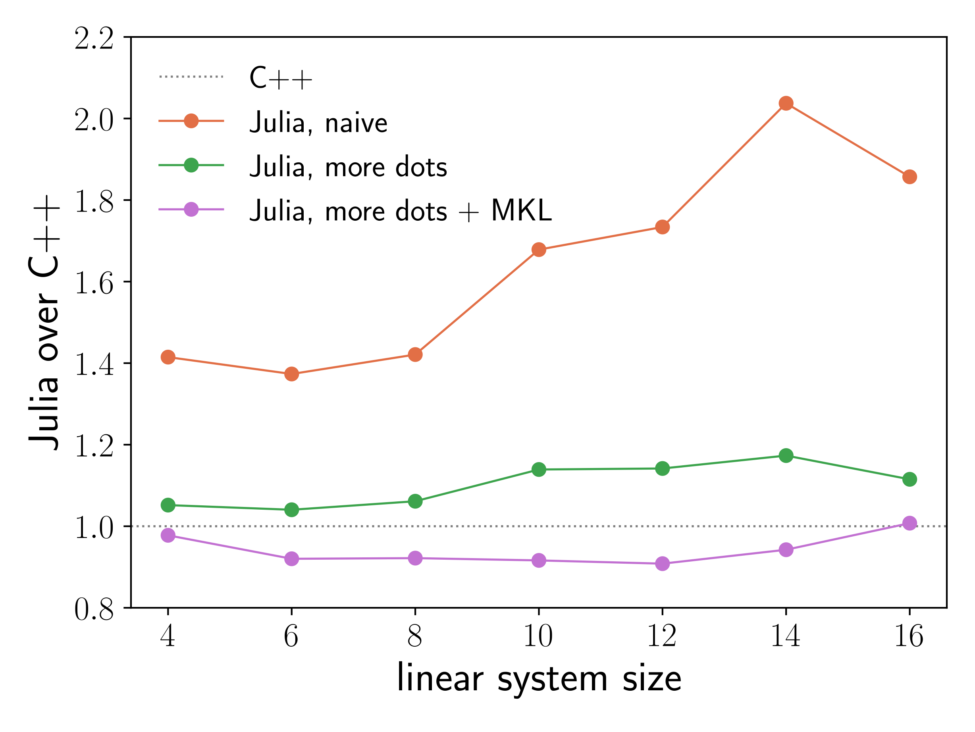
Personal Experience: Large-Scale Quantum Monte Carlo
Condensed matter physics application
Prototypical Julia implementation
~3x faster than Python (not shown)
Within a factor of ~2x compared to C++
Could gradually improve performance
No disruptive language change necessary!
A lot of fun!
improved
optimized

Slide 10


Bridging the Gap
Laptop
HPC Cluster
Start with HPC on your laptop and transition to clusters!

Slide 11
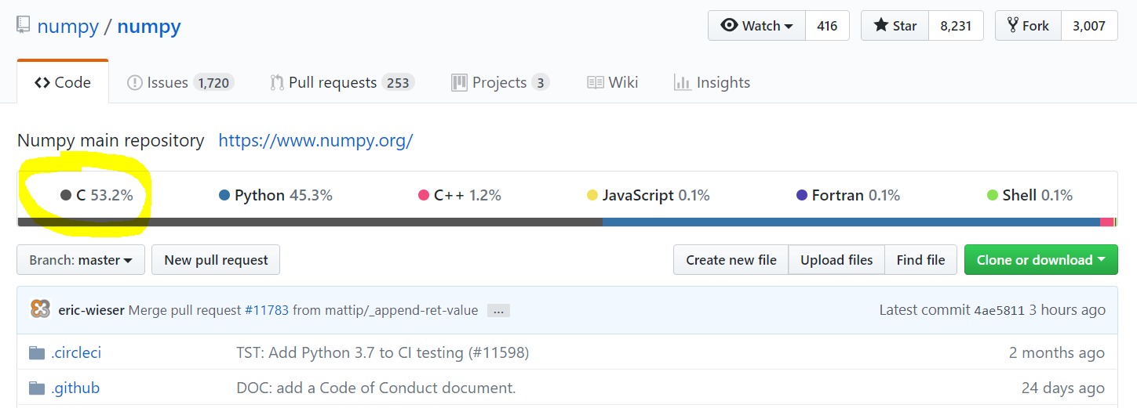





Bridging the Gap
User
Developer

Slide 12

Vandermonde matrix
vander(x)

Slide 13
numpy.vander(x)

Slide 14


Python
calls
def vander(x, N=None, increasing=False):
x = asarray(x)
if x.ndim != 1:
raise ValueError("x must be a one-dimensional array or sequence.")
if N is None:
N = len(x)
v = empty((len(x), N), dtype=promote_types(x.dtype, int))
tmp = v[:, ::-1] if not increasing else v
if N > 0:
tmp[:, 0] = 1
if N > 1:
tmp[:, 1:] = x[:, None]
multiply.accumulate(tmp[:, 1:], out=tmp[:, 1:], axis=1)
return v
C code
PyUFunc_Accumulate(PyUFuncObject *ufunc, PyArrayObject *arr, PyArrayObject *out,
int axis, int otype)
{
PyArrayObject *op[2];
PyArray_Descr *op_dtypes[2] = {NULL, NULL};
int op_axes_arrays[2][NPY_MAXDIMS];
int *op_axes[2] = {op_axes_arrays[0], op_axes_arrays[1]};
npy_uint32 op_flags[2];
int idim, ndim, otype_final;
int needs_api, need_outer_iterator;
NpyIter *iter = NULL, *iter_inner = NULL;
/* The selected inner loop */
PyUFuncGenericFunction innerloop = NULL;
void *innerloopdata = NULL;
const char *ufunc_name = ufunc_get_name_cstr(ufunc);
/* These parameters come from extobj= or from a TLS global */
int buffersize = 0, errormask = 0;
NPY_BEGIN_THREADS_DEF;
NPY_UF_DBG_PRINT1("\nEvaluating ufunc %s.accumulate\n", ufunc_name);
#if 0
printf("Doing %s.accumulate on array with dtype : ", ufunc_name);
PyObject_Print((PyObject *)PyArray_DESCR(arr), stdout, 0);
printf("\n");
#endif
if (_get_bufsize_errmask(NULL, "accumulate", &buffersize, &errormask) < 0) {
return NULL;
}
/* Take a reference to out for later returning */
Py_XINCREF(out);
otype_final = otype;
if (get_binary_op_function(ufunc, &otype_final,
&innerloop, &innerloopdata) < 0) {
PyArray_Descr *dtype = PyArray_DescrFromType(otype);
PyErr_Format(PyExc_ValueError,
"could not find a matching type for %s.accumulate, "
"requested type has type code '%c'",
ufunc_name, dtype ? dtype->type : '-');
Py_XDECREF(dtype);
goto fail;
}
ndim = PyArray_NDIM(arr);
/*
* Set up the output data type, using the input's exact
* data type if the type number didn't change to preserve
* metadata
*/
if (PyArray_DESCR(arr)->type_num == otype_final) {
if (PyArray_ISNBO(PyArray_DESCR(arr)->byteorder)) {
op_dtypes[0] = PyArray_DESCR(arr);
Py_INCREF(op_dtypes[0]);
}
else {
op_dtypes[0] = PyArray_DescrNewByteorder(PyArray_DESCR(arr),
NPY_NATIVE);
}
}
else {
op_dtypes[0] = PyArray_DescrFromType(otype_final);
}
if (op_dtypes[0] == NULL) {
goto fail;
}
#if NPY_UF_DBG_TRACING
printf("Found %s.accumulate inner loop with dtype : ", ufunc_name);
PyObject_Print((PyObject *)op_dtypes[0], stdout, 0);
printf("\n");
#endif
/* Set up the op_axes for the outer loop */
for (idim = 0; idim < ndim; ++idim) {
op_axes_arrays[0][idim] = idim;
op_axes_arrays[1][idim] = idim;
}
/* The per-operand flags for the outer loop */
op_flags[0] = NPY_ITER_READWRITE |
NPY_ITER_NO_BROADCAST |
NPY_ITER_ALLOCATE |
NPY_ITER_NO_SUBTYPE;
op_flags[1] = NPY_ITER_READONLY;
op[0] = out;
op[1] = arr;
need_outer_iterator = (ndim > 1);
/* We can't buffer, so must do UPDATEIFCOPY */
if (!PyArray_ISALIGNED(arr) || (out && !PyArray_ISALIGNED(out)) ||
!PyArray_EquivTypes(op_dtypes[0], PyArray_DESCR(arr)) ||
(out &&
!PyArray_EquivTypes(op_dtypes[0], PyArray_DESCR(out)))) {
need_outer_iterator = 1;
}
/* If input and output overlap in memory, use iterator to figure it out */
else if (out != NULL && solve_may_share_memory(out, arr, NPY_MAY_SHARE_BOUNDS) != 0) {
need_outer_iterator = 1;
}
if (need_outer_iterator) {
int ndim_iter = 0;
npy_uint32 flags = NPY_ITER_ZEROSIZE_OK|
NPY_ITER_REFS_OK|
NPY_ITER_COPY_IF_OVERLAP;
PyArray_Descr **op_dtypes_param = NULL;
/*
* The way accumulate is set up, we can't do buffering,
* so make a copy instead when necessary.
*/
ndim_iter = ndim;
flags |= NPY_ITER_MULTI_INDEX;
/*
* Add some more flags.
*
* The accumulation outer loop is 'elementwise' over the array, so turn
* on NPY_ITER_OVERLAP_ASSUME_ELEMENTWISE. That is, in-place
* accumulate(x, out=x) is safe to do without temporary copies.
*/
op_flags[0] |= NPY_ITER_UPDATEIFCOPY|NPY_ITER_ALIGNED|NPY_ITER_OVERLAP_ASSUME_ELEMENTWISE;
op_flags[1] |= NPY_ITER_COPY|NPY_ITER_ALIGNED|NPY_ITER_OVERLAP_ASSUME_ELEMENTWISE;
op_dtypes_param = op_dtypes;
op_dtypes[1] = op_dtypes[0];
NPY_UF_DBG_PRINT("Allocating outer iterator\n");
iter = NpyIter_AdvancedNew(2, op, flags,
NPY_KEEPORDER, NPY_UNSAFE_CASTING,
op_flags,
op_dtypes_param,
ndim_iter, op_axes, NULL, 0);
if (iter == NULL) {
goto fail;
}
/* In case COPY or UPDATEIFCOPY occurred */
op[0] = NpyIter_GetOperandArray(iter)[0];
op[1] = NpyIter_GetOperandArray(iter)[1];
if (NpyIter_RemoveAxis(iter, axis) != NPY_SUCCEED) {
goto fail;
}
if (NpyIter_RemoveMultiIndex(iter) != NPY_SUCCEED) {
goto fail;
}
}
/* Get the output */
if (out == NULL) {
if (iter) {
op[0] = out = NpyIter_GetOperandArray(iter)[0];
Py_INCREF(out);
}
else {
PyArray_Descr *dtype = op_dtypes[0];
Py_INCREF(dtype);
op[0] = out = (PyArrayObject *)PyArray_NewFromDescr(
&PyArray_Type, dtype,
ndim, PyArray_DIMS(op[1]), NULL, NULL,
0, NULL);
if (out == NULL) {
goto fail;
}
}
}
/*
* If the reduction axis has size zero, either return the reduction
* unit for UFUNC_REDUCE, or return the zero-sized output array
* for UFUNC_ACCUMULATE.
*/
if (PyArray_DIM(op[1], axis) == 0) {
goto finish;
}
else if (PyArray_SIZE(op[0]) == 0) {
goto finish;
}
if (iter && NpyIter_GetIterSize(iter) != 0) {
char *dataptr_copy[3];
npy_intp stride_copy[3];
npy_intp count_m1, stride0, stride1;
NpyIter_IterNextFunc *iternext;
char **dataptr;
int itemsize = op_dtypes[0]->elsize;
/* Get the variables needed for the loop */
iternext = NpyIter_GetIterNext(iter, NULL);
if (iternext == NULL) {
goto fail;
}
dataptr = NpyIter_GetDataPtrArray(iter);
/* Execute the loop with just the outer iterator */
count_m1 = PyArray_DIM(op[1], axis)-1;
stride0 = 0, stride1 = PyArray_STRIDE(op[1], axis);
NPY_UF_DBG_PRINT("UFunc: Reduce loop with just outer iterator\n");
stride0 = PyArray_STRIDE(op[0], axis);
stride_copy[0] = stride0;
stride_copy[1] = stride1;
stride_copy[2] = stride0;
needs_api = NpyIter_IterationNeedsAPI(iter);
NPY_BEGIN_THREADS_NDITER(iter);
do {
dataptr_copy[0] = dataptr[0];
dataptr_copy[1] = dataptr[1];
dataptr_copy[2] = dataptr[0];
/*
* Copy the first element to start the reduction.
*
* Output (dataptr[0]) and input (dataptr[1]) may point to
* the same memory, e.g. np.add.accumulate(a, out=a).
*/
if (otype == NPY_OBJECT) {
/*
* Incref before decref to avoid the possibility of the
* reference count being zero temporarily.
*/
Py_XINCREF(*(PyObject **)dataptr_copy[1]);
Py_XDECREF(*(PyObject **)dataptr_copy[0]);
*(PyObject **)dataptr_copy[0] =
*(PyObject **)dataptr_copy[1];
}
else {
memmove(dataptr_copy[0], dataptr_copy[1], itemsize);
}
if (count_m1 > 0) {
/* Turn the two items into three for the inner loop */
dataptr_copy[1] += stride1;
dataptr_copy[2] += stride0;
NPY_UF_DBG_PRINT1("iterator loop count %d\n",
(int)count_m1);
innerloop(dataptr_copy, &count_m1,
stride_copy, innerloopdata);
}
} while (iternext(iter));
NPY_END_THREADS;
}
else if (iter == NULL) {
char *dataptr_copy[3];
npy_intp stride_copy[3];
int itemsize = op_dtypes[0]->elsize;
/* Execute the loop with no iterators */
npy_intp count = PyArray_DIM(op[1], axis);
npy_intp stride0 = 0, stride1 = PyArray_STRIDE(op[1], axis);
NPY_UF_DBG_PRINT("UFunc: Reduce loop with no iterators\n");
if (PyArray_NDIM(op[0]) != PyArray_NDIM(op[1]) ||
!PyArray_CompareLists(PyArray_DIMS(op[0]),
PyArray_DIMS(op[1]),
PyArray_NDIM(op[0]))) {
PyErr_SetString(PyExc_ValueError,
"provided out is the wrong size "
"for the reduction");
goto fail;
}
stride0 = PyArray_STRIDE(op[0], axis);
stride_copy[0] = stride0;
stride_copy[1] = stride1;
stride_copy[2] = stride0;
/* Turn the two items into three for the inner loop */
dataptr_copy[0] = PyArray_BYTES(op[0]);
dataptr_copy[1] = PyArray_BYTES(op[1]);
dataptr_copy[2] = PyArray_BYTES(op[0]);
/*
* Copy the first element to start the reduction.
*
* Output (dataptr[0]) and input (dataptr[1]) may point to the
* same memory, e.g. np.add.accumulate(a, out=a).
*/
if (otype == NPY_OBJECT) {
/*
* Incref before decref to avoid the possibility of the
* reference count being zero temporarily.
*/
Py_XINCREF(*(PyObject **)dataptr_copy[1]);
Py_XDECREF(*(PyObject **)dataptr_copy[0]);
*(PyObject **)dataptr_copy[0] =
*(PyObject **)dataptr_copy[1];
}
else {
memmove(dataptr_copy[0], dataptr_copy[1], itemsize);
}
if (count > 1) {
--count;
dataptr_copy[1] += stride1;
dataptr_copy[2] += stride0;
NPY_UF_DBG_PRINT1("iterator loop count %d\n", (int)count);
needs_api = PyDataType_REFCHK(op_dtypes[0]);
if (!needs_api) {
NPY_BEGIN_THREADS_THRESHOLDED(count);
}
innerloop(dataptr_copy, &count,
stride_copy, innerloopdata);
NPY_END_THREADS;
}
}
finish:
Py_XDECREF(op_dtypes[0]);
NpyIter_Deallocate(iter);
NpyIter_Deallocate(iter_inner);
return (PyObject *)out;
fail:
Py_XDECREF(out);
Py_XDECREF(op_dtypes[0]);
NpyIter_Deallocate(iter);
NpyIter_Deallocate(iter_inner);
return NULL;
}
@TYPE@_@kind@(char **args, npy_intp *dimensions, npy_intp *steps, void *NPY_UNUSED(func))
{
if (IS_BINARY_REDUCE) {
#if @PW@
@type@ * iop1 = (@type@ *)args[0];
npy_intp n = dimensions[0];
*iop1 @OP@= pairwise_sum_@TYPE@(args[1], n, steps[1]);
#else
BINARY_REDUCE_LOOP(@type@) {
io1 @OP@= *(@type@ *)ip2;
}
*((@type@ *)iop1) = io1;
#endif
}
else if (!run_binary_simd_@kind@_@TYPE@(args, dimensions, steps)) {
BINARY_LOOP {
const @type@ in1 = *(@type@ *)ip1;
const @type@ in2 = *(@type@ *)ip2;
*((@type@ *)op1) = in1 @OP@ in2;
}
}
}
uses
C template

Slide 15
Julia
function vander(x::AbstractVector{T}) where T
m = length(x)
V = Matrix{T}(undef, m, m)
for j = 1:m
V[j,1] = one(x[j])
end
for i= 2:m
for j = 1:m
V[j,i] = x[j] * V[j,i-1]
end
end
return V
end

Slide 16
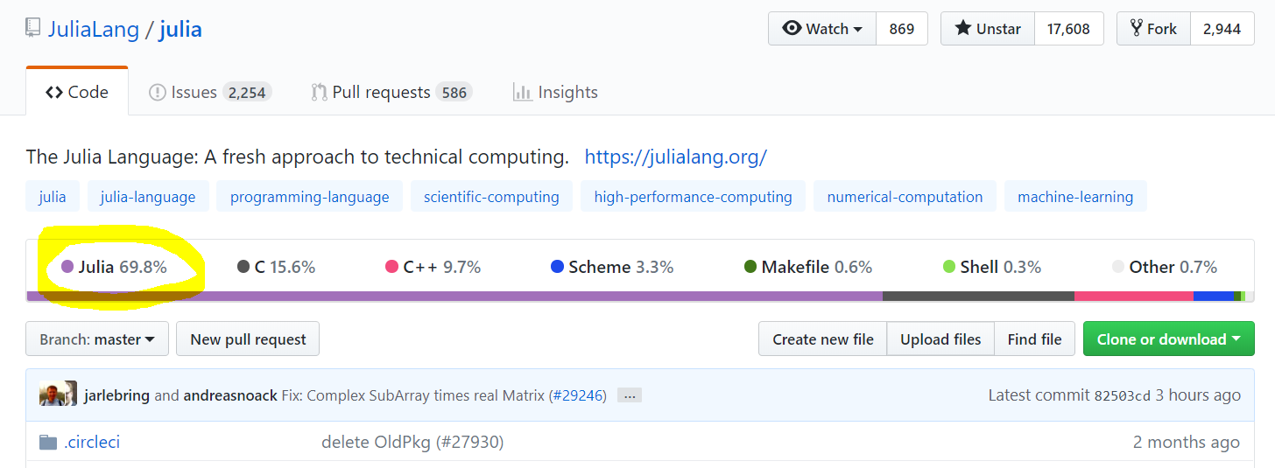

Bridging the Gap
User
Developer

Slide 17
Julia for HPC

Slide 18
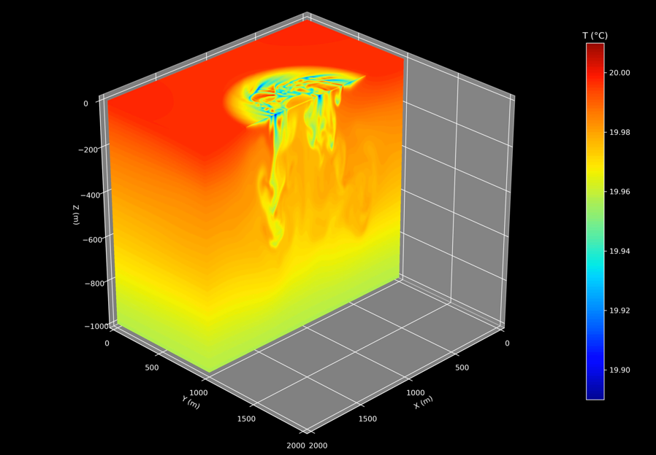

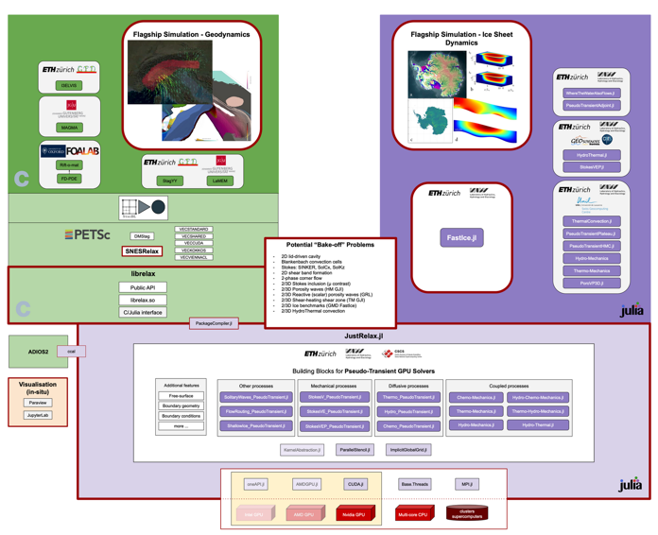
International Initiatives
CliMA @ Caltech, MIT
Climate Modeling Alliance
CESMIX @ MIT
Center for the exascale simulation of materials in extreme environment
ExaSGD @ LLNL, ORNL, …
National power grid optimization
GPU4GEO @ ETH / CSCS
Computational earth science
…
Oceananigans.jl

Slide 19
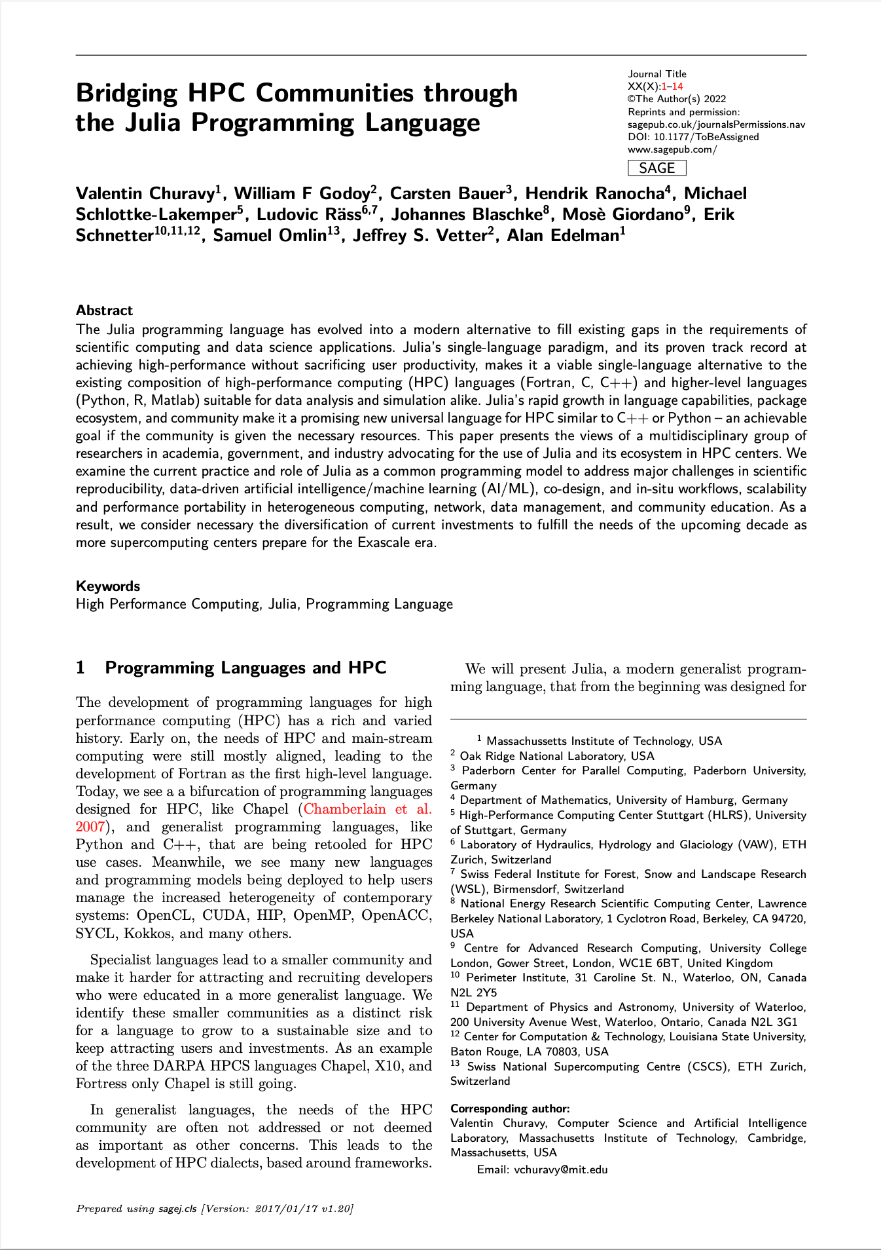
Julia HPC Position Paper
(in preparation)
USA / Canada
MIT Massachussets Institute of Technology
NERSC National Energy Research Scientific Computing
ORNL Oak Ridge National Laboratory
PI Perimeter Institute for Theoretical Physics
Europe
PC2 Paderborn Center for Parallel Computing
HLRS High-Performance Computing Center Stuttgart
UHH University of Hamburg
CSCS Swiss National Supercomputing Centre
ETH Swiss Federal Institute of Technology Zürich
ARC@UCL University College London

Slide 20




Julia HPC Community
Julia Slack
Channel: #hpc
julialang.org/slack/
Monthly JuliaHPC Call
julialang.org/community/#events
JuliaCon 2022
27 – 29 July
Recording: https://www.youtube.com/watch?v=fog1x9rs71Q

Slide 21































Notes:
Universities teaching Julia

Slide 22
Let’s get started! ☺
github.com/carstenbauer/JuliaHLRS22

Slide 23
Attribution / Copyright
Laptop: Laptop Vectors by Vecteezy
Cluster: Web Vectors by Vecteezy

Slide 24
HPC Ecosystem

Slide 25
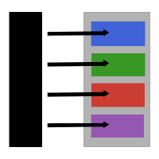


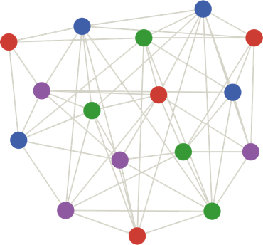





HPC Ecosystem
JuliaSIMD
LoopVectorization.jl, Polyester.jl
JuliaParallel
Dagger.jl, MPI.jl
JuliaFolds
Transducers.jl, FLoops.jl
JuliaPerf
LIKWID.jl, PProf.jl
JuliaGPU
CUDA.jl, AMDGPU.jl
pc2.de/go/jlpkg

Slide 26

Julia Packages by PC2
ThreadPinning.jl
Dynamically pin Julia threads to CPU threads
STREAMBenchmark.jl & BandwidthBenchmark.jl
Memory bandwidth measurements
LIKWID.jl
Hardware performance monitoring
GPUInspector.jl
Benchmark max. GPU performance
GPU node stresstest: monitor temperature & power
pc2.de/go/jlpkg

Slide 27
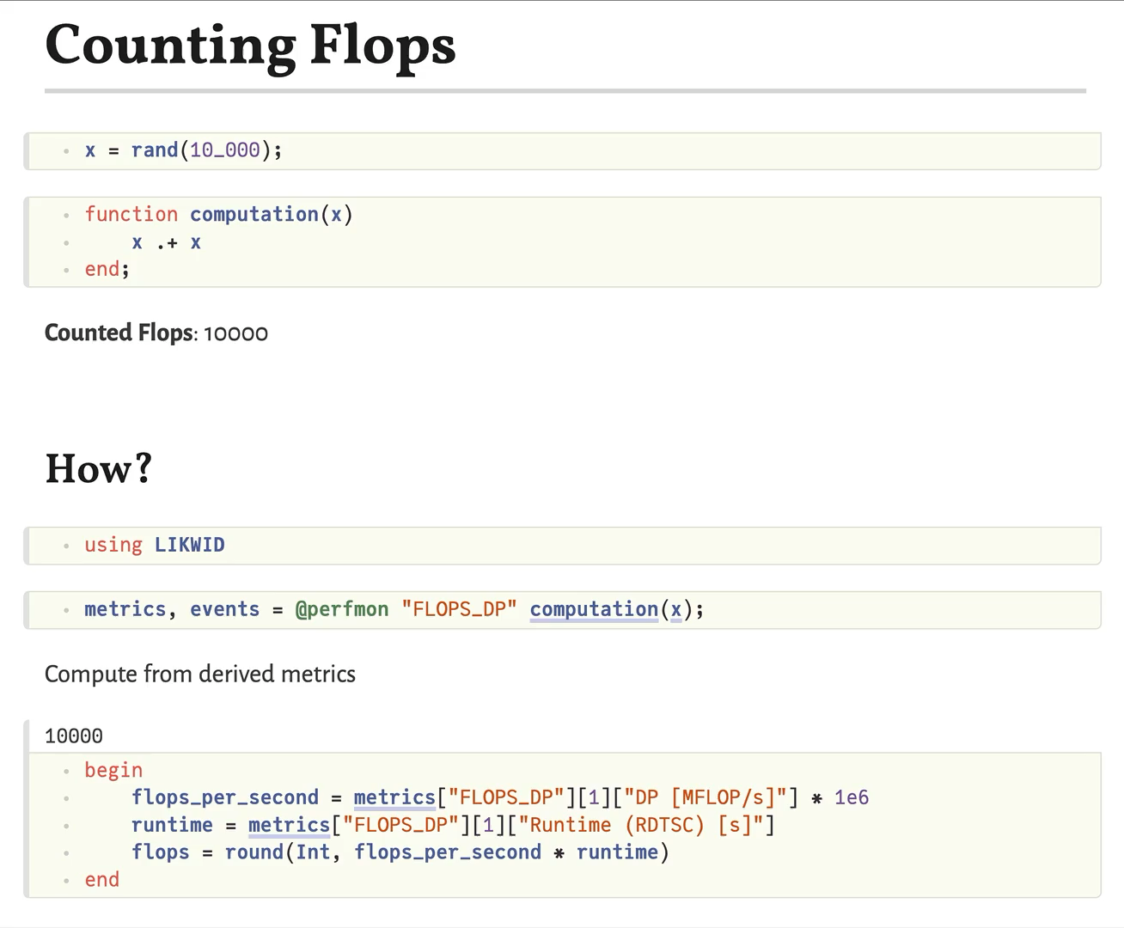
Reactive Performance Monitoring
Pluto.jl + LIKWID.jl

Slide 28
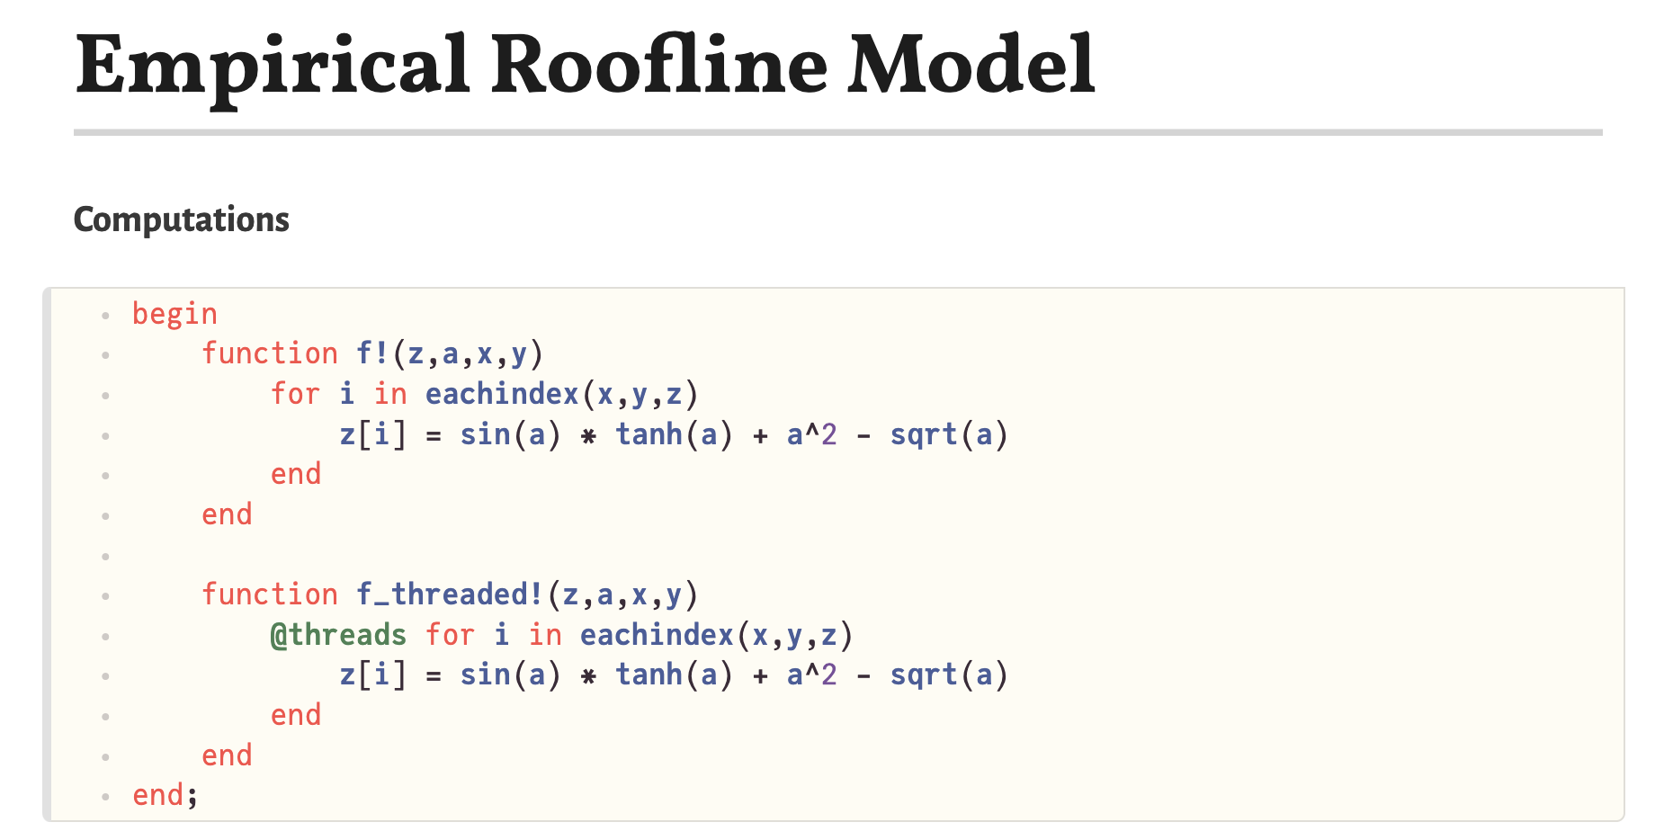
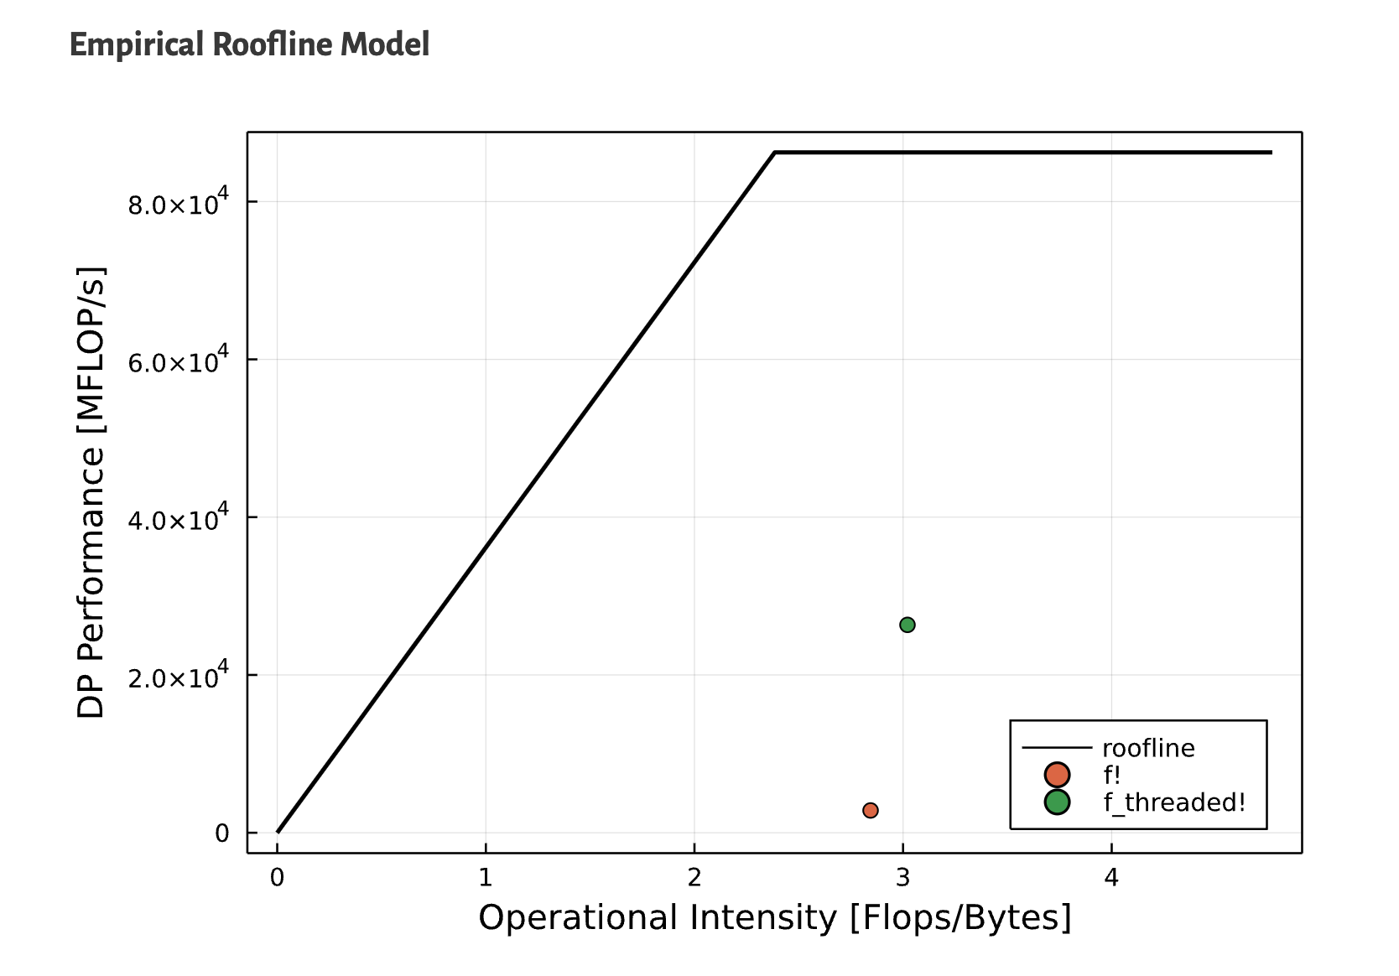
Reactive Performance Monitoring

Slide 29
Code
@which
@less
@edit
Macro Exp.
@macroexpand
IR
@code_lowered
Typed IR
@code_warntype
@code_typed
LLVM IR
@code_llvm
Assembly
@code_native

Slide 30
T
T == S
S
d(x::T, y::S) where {T,S}

